Slide 1
EXAMINATION TOOLS APPLYING BLOCK CHAIN TECHNOLOGY
4

Slide 2
SUPERVISORS:
Mr. Kiều Trọng Khánh
4
OUR TEAM:
Nguyễn Minh Hưng – Leader
Cao Trung Hiếu – Member
Trương Tấn Sang – Member

Slide 3
OVERVIEW
1. INTRODUCTION
2. CURRENT ISSUE & SOLUTION
3. OUTCOME & LIMITATIONS
4. FUTURE PLAN
5. Q & A

Slide 4
INTRODUCTION
1

Slide 5
INTRODUCTION
- We build Examination System to organize test exam by Learning Outcomes and Chapters. We also improve questions management and test exams quality.

Slide 6
INTRODUCTION
- We build Examination System to organize test exam by Learning Outcomes and Chapters. We also improve questions management and test exams quality.
- Examination Tool reduces cheating and manages student’s computer processes better.

Slide 7
INTRODUCTION
- We build Examination System to organize test exam by Learning Outcomes and Chapters. We also improve questions management and test exams quality.
- Examination Tool reduces cheating and manages student’s computer processes better.
- We apply blockchain in approving test exam process to guarantee its integrity.
Notes:
--- Database ai thiết kế outline

Slide 8
CURRENT ISSUE & SOLUTION
2

Slide 9
CURRENT PROCESS


Teacher
CREATE QUESTIONS

Slide 10
CURRENT PROCESS


GENERATE TEST EXAM
Staff
Teacher
CREATE QUESTIONS

Slide 11
CURRENT PROCESS


GENERATE TEST EXAM
Staff
Teacher
Teacher
CREATE QUESTIONS
APPROVE TEST EXAM

Slide 12
CURRENT PROCESS


GENERATE TEST EXAM
Staff
Teacher
Teacher
CREATE QUESTIONS
APPROVE TEST EXAM
if teacher reject test exam

Slide 13
CURRENT PROCESS


GENERATE TEST EXAM
CREATE EXAM
Staff
Staff
Teacher
Teacher
CREATE QUESTIONS
APPROVE TEST EXAM
if teacher reject test exam

Slide 14
CURRENT PROCESS



GENERATE TEST EXAM
CREATE EXAM
Staff
Staff
Teacher
Teacher
Student
CREATE QUESTIONS
APPROVE TEST EXAM
TAKE TEST EXAM
if teacher reject test exam
Notes:
OK

Slide 15
CURRENT PROCESS ISSUE
01
TEST EXAM QUALITY IS LOW
Notes:
Ko co

Slide 16
CURRENT PROCESS ISSUE
01
TEST EXAM QUALITY IS LOW
02
DUPLICATED QUESTIONS

Slide 17
CURRENT PROCESS ISSUE
01
TEST EXAM QUALITY IS LOW
02
DUPLICATED QUESTIONS
03
MANAGING UNACCEPTED TOOL IS INFLEXIBLE.
Notes:
À có- We build Examination System to organize test exam by Learning Outcomes and Chapters. Also, to improve questions and test exams quality.
- Examination Tool reduces cheating and manages Student’s computer processes better.

Slide 18
IMPORT QUESTION ISSUE



GENERATE TEST EXAM
CREATE EXAM
Staff
Staff
Teacher
Teacher
Student
CREATE QUESTIONS
APPROVE TEST EXAM
TAKE A TEST EXAM
if teacher reject test exam

Slide 19
IMPORT QUESTION ISSUE
ISSUE
SOLUTIONS
HANDLING
ALGORITHMS
DATA STRUCTURE
DEMO
- Teacher wants to add questions to question bank
Teacher

Slide 20
IMPORT QUESTION ISSUE
ISSUE
SOLUTIONS
HANDLING
ALGORITHMS
DATA STRUCTURE
DEMO
- Teacher wants to add questions to question bank
Teacher

Slide 21
IMPORT QUESTION ISSUE
ISSUE
SOLUTIONS
HANDLING
ALGORITHMS
DATA STRUCTURE
DEMO
- Teacher wants to add questions to question bank
Upload file
Or
Teacher
Create question

Slide 22
IMPORT QUESTION ISSUE
ISSUE
SOLUTIONS
HANDLING
ALGORITHMS
DATA STRUCTURE
DEMO
- Teacher wants to add questions to question bank
Upload file
Or
Teacher
Create question
Question bank

Slide 23
IMPORT QUESTION ISSUE
ISSUE
SOLUTIONS
HANDLING
ALGORITHMS
DATA STRUCTURE
DEMO
Another teacher wants to add questions to question bank too.
Another teacher
Notes:
Ok? ok

Slide 24
IMPORT QUESTION ISSUE
ISSUE
SOLUTIONS
HANDLING
ALGORITHMS
DATA STRUCTURE
DEMO
Another teacher wants to add questions to question bank too.
Upload file
Another teacher
Question File

Slide 25
IMPORT QUESTION ISSUE
ISSUE
SOLUTIONS
HANDLING
ALGORITHMS
DATA STRUCTURE
DEMO
Another teacher wants to add questions to question bank too. But some questions in this file are existed in question bank.
Upload file
Upload to
Another teacher
Question File
Question bank
Notes:
Ok vậy đi

Slide 26

IMPORT QUESTION ISSUE
ISSUE
SOLUTIONS
HANDLING
ALGORITHMS
DATA STRUCTURE
DEMO
Issue:
Duplicated questions in question bank.
Waste of server’s storage.
Notes:
ok

Slide 27
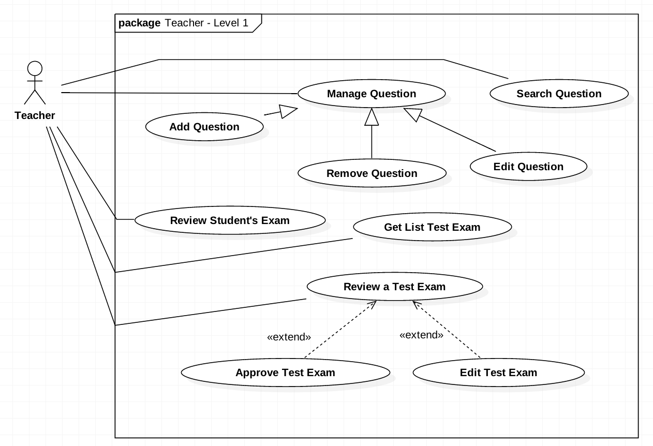
IMPORT QUESTION SOLUTION
ISSUE
SOLUTIONS
HANDLING
ALGORITHMS
DATA STRUCTURE
DEMO

Slide 28
IMPORT QUESTION SOLUTION
ISSUE
SOLUTIONS
HANDLING
ALGORITHMS
DATA STRUCTURE
DEMO
01

SUPORT FILE IMPORT BY MOODLE FORMAT




Slide 29
IMPORT QUESTION SOLUTION
ISSUE
SOLUTIONS
HANDLING
ALGORITHMS
DATA STRUCTURE
DEMO
01

SUPORT FILE IMPORT BY MOODLE FORMAT

02
WARN DUPLICATED QUESTIONS & EDIT BEFORE SAVE TO DATABASE



Slide 30
IMPORT QUESTION SOLUTION
ISSUE
SOLUTIONS
HANDLING
ALGORITHMS
DATA STRUCTURE
DEMO
01

SUPORT FILE IMPORT BY MOODLE FORMAT

02
WARN DUPLICATED QUESTIONS & EDIT BEFORE SAVE TO DATABASE



Slide 31
IMPORT QUESTION SOLUTION
ISSUE
SOLUTIONS
HANDLING
ALGORITHMS
DATA STRUCTURE
DEMO
01

SUPORT FILE IMPORT BY MOODLE FORMAT

02
WARN DUPLICATED QUESTIONS & EDIT BEFORE SAVE TO DATABASE
03

CHECK DUPLICATES BY THREAD


Slide 32
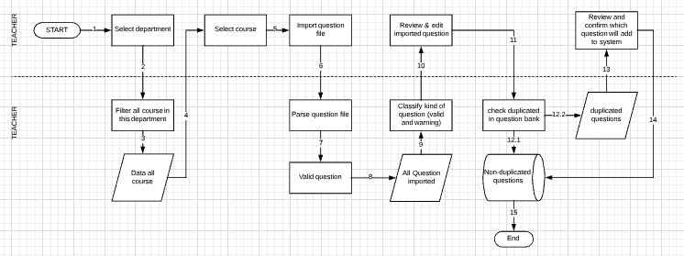
IMPORT FLOW HANDLING
ISSUE
SOLUTIONS
HANDLING
ALGORITHMS
DATA STRUCTURE
DEMO
System
In this department

Slide 33
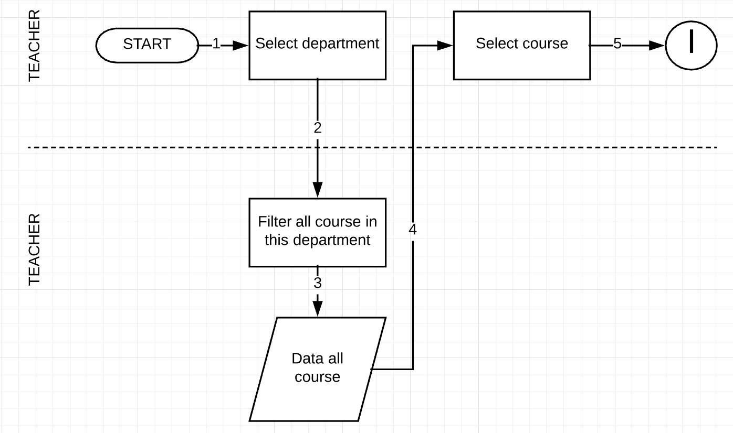
IMPORT FLOW HANDLING
ISSUE
SOLUTIONS
HANDLING
ALGORITHMS
DATA STRUCTURE
DEMO
System
In this department

Slide 34
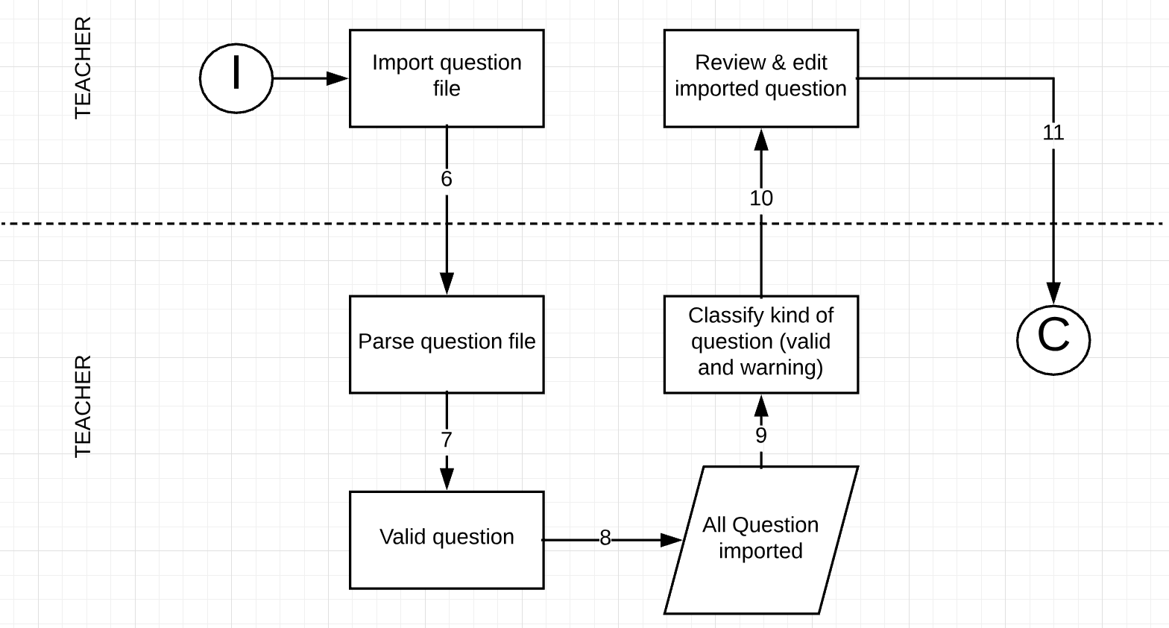
IMPORT FLOW HANDLING
ISSUE
SOLUTIONS
HANDLING
ALGORITHMS
DATA STRUCTURE
DEMO
System
Notes:
Ghi

Slide 35
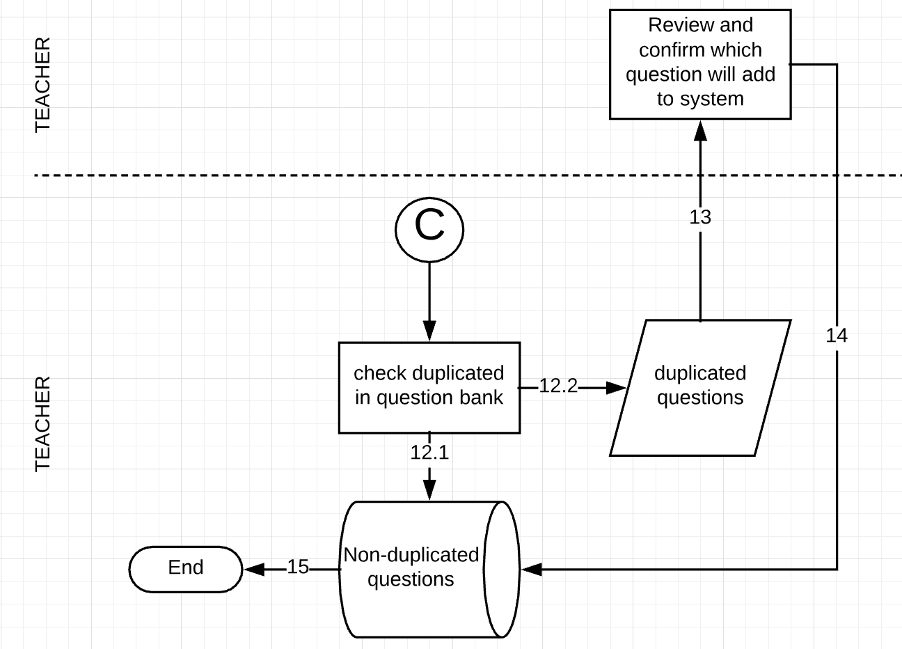
IMPORT FLOW HANDLING
ISSUE
SOLUTIONS
HANDLING
ALGORITHMS
DATA STRUCTURE
DEMO
System

Slide 36
CALCULATING PERCENTAGE SIMILARITY OF 2 QUESTION
ISSUE
SOLUTIONS
HANDLING
ALGORITHMS
DATA STRUCTURE
DEMO
Levenshtein distance algorithm is used to identify the differences between the range of 2 sequences. The range between these sequences is the minimum steps to make one sequence become the other one. This algorithm includes 3 changing functions:
Remove a character
Add a new character
Replace with another character
Reference: https://en.wikipedia.org/wiki/Levenshtein_distance

Slide 37
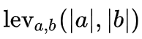
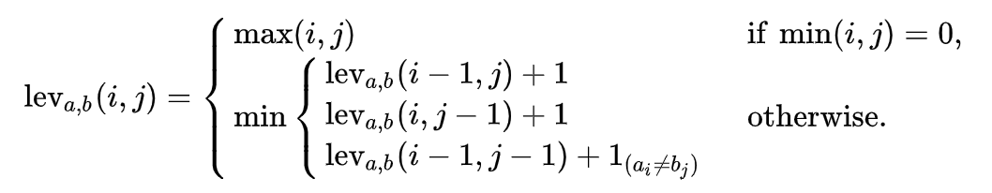
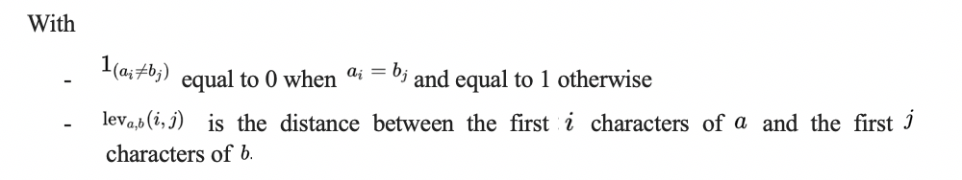
Calculating Percentage Similarity of 2 Questions
ISSUE
SOLUTIONS
HANDLING
ALGORITHMS
DATA STRUCTURE
Mathematically, the Levenshtein distance between two strings a, b (of length |a| and |b| respectively) is given by
, where:
Reference: https://en.wikipedia.org/wiki/Levenshtein_distance

Slide 38
CALCULATING PERCENTAGE SIMILARITY OF 2 QUESTION
ISSUE
SOLUTIONS
HANDLING
ALGORITHMS
DATA STRUCTURE
Example: To change “kitten” to “sitting”, we have to use at least 3 changing times as following:
kitten -> sitten (replace "k" with "s")
sitten -> sittin (replace "e" with "i")
sittin -> sitting (add "g")

Slide 39
CALCULATING PERCENTAGE SIMILARITY OF 2 QUESTION
ISSUE
SOLUTIONS
HANDLING
ALGORITHMS
DATA STRUCTURE
DEMO
Percentage Similarity = 100 -
Max(Length_{a} , Length_{b})

Slide 40
CALCULATING PERCENTAGE SIMILARITY OF 2 QUESTION
ISSUE
SOLUTIONS
HANDLING
ALGORITHMS
DATA STRUCTURE
DEMO
Percentage Similarity = 100 -
Max(Length_{a} , Length_{b})
If Percentage Similarity > 60%

Slide 41
CALCULATING PERCENTAGE SIMILARITY OF 2 QUESTION
ISSUE
SOLUTIONS
HANDLING
ALGORITHMS
DATA STRUCTURE
DEMO
Percentage Similarity = 100 -
Max(Length_{a} , Length_{b})
If Percentage Similarity > 60%

Slide 42
CALCULATING PERCENTAGE SIMILARITY OF 2 QUESTION
ISSUE
SOLUTIONS
HANDLING
ALGORITHMS
DATA STRUCTURE
DEMO
Percentage Similarity = 100 -
Max(Length_{a} , Length_{b})
If Percentage Similarity > 60%
Warning to Teacher

Slide 43
QUESTION’S DATA STRUCTURE
ISSUE
SOLUTIONS
HANDLING
ALGORITHMS
DATA STRUCTURE
DEMO
Mark
Chapter
.
.
.
Question
Answers

Slide 44
QUESTION’S DATA STRUCTURE
ISSUE
SOLUTIONS
HANDLING
ALGORITHMS
DATA STRUCTURE
DEMO
Mark
Chapter
.
.
.
Question
Answers

Slide 45
QUESTION’S DATA STRUCTURE
ISSUE
SOLUTIONS
HANDLING
ALGORITHMS
DATA STRUCTURE
DEMO
Mark
Chapter
.
.
.
Question
Answers
”QuestionContent + AnswerContents”

Slide 46
QUESTION’S DATA STRUCTURE
ISSUE
SOLUTIONS
HANDLING
ALGORITHMS
DATA STRUCTURE
DEMO
Mark
Chapter
.
.
.
Question
Answers
Compare
+
”QuestionContent + AnswerContents”

Slide 47
OUR IMPORT QUESTION DEMO PROCESS
ISSUE
SOLUTIONS
HANDLING
ALGORITHMS
DATA STRUCTURE
DEMO
Select department
1
Select course
2
Import File
3
Mr.Khanh
Review
4
View list may duplicate
5
Done
6

Slide 48
GENERATE TEST EXAM ISSUE



GENERATE TEST EXAM
CREATE EXAM
Staff
Staff
Teacher
Teacher
Student
CREATE QUESTIONS
APPROVE TEST EXAM
TAKE TEST EXAM
if teacher reject test exam

Slide 49

GENERATE TEST EXAM ISSUE
ISSUE
LEARNING OUTCOMES
SOLUTIONS
DEMO
Staff wants to create a test exam.
Staff

Slide 50
GENERATE TEST EXAM ISSUE
ISSUE
LEARNING OUTCOMES
SOLUTIONS
DEMO
Staff wants to create a test exam.
Generate
by chapters
Staff

Slide 51

GENERATE TEST EXAM ISSUE
ISSUE
LEARNING OUTCOMES
SOLUTIONS
DEMO
Staff wants to create a test exam.
Generate
by chapters
Staff
Test Exam

Slide 52
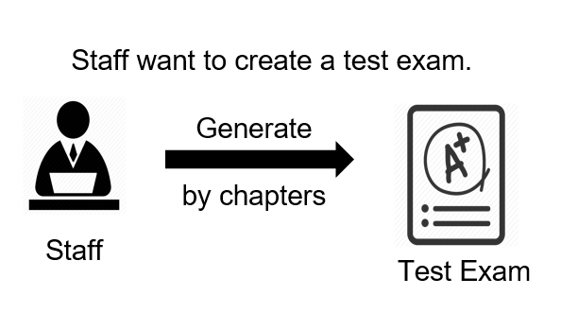
GENERATE TEST EXAM ISSUE
ISSUE
LEARNING OUTCOMES
SOLUTIONS
DEMO
Issue:
Test exam quality is low.
Test exam content can be duplicated.

Slide 53
GENERATE TEST EXAM ISSUE
ISSUE
LEARNING OUTCOMES
SOLUTIONS
DEMO
Issue:
Test exam quality is low.
Test exam content can be duplicated.
WHY GENERATE TEST EXAM LEAD TO THOSE ISSUES?

Slide 54
GENERATE TEST EXAM ISSUE
ISSUE
LEARNING OUTCOMES
SOLUTIONS
DEMO
📖
Web-based Java Applications Course

Slide 55
GENERATE TEST EXAM ISSUE
ISSUE
LEARNING OUTCOMES
SOLUTIONS
DEMO
Chapter 10
📖
Web-based Java Applications Course
…
Chapter 1

Slide 56
GENERATE TEST EXAM ISSUE
ISSUE
LEARNING OUTCOMES
SOLUTIONS
DEMO
JSP
Chapter 10
Java bean
📖
Servlet
Web-based Java Applications Course
HTML
…
…
Course
Objectives
Chapter 1

Slide 57
GENERATE TEST EXAM ISSUE
ISSUE
LEARNING OUTCOMES
SOLUTIONS
DEMO
JSP
10 Questions
Chapter 10
Java bean
10 Questions
📖
Servlet
10 Questions
Web-based Java Applications Course
HTML
10 Questions
…
…
…
Course
Objectives
Chapter 1
10 Questions

Slide 58
GENERATE TEST EXAM ISSUE
ISSUE
LEARNING OUTCOMES
SOLUTIONS
DEMO
Generate test exam
JSP
10 Questions
Chapter 10
Java bean
10 Questions
📖
Servlet
10 Questions
Test exam
Web-based Java Applications Course
HTML
10 Questions
…
…
…
Course
Objectives
Chapter 1
10 Questions

Slide 59
GENERATE TEST EXAM ISSUE
ISSUE
LEARNING OUTCOMES
SOLUTIONS
DEMO
Generate test exam
JSP
10 Questions
Chapter 10
Java bean
10 Questions
📖
Servlet
10 Questions
Test exam
Web-based Java Applications Course
HTML
10 Questions
…
…
…
Course
Objectives
Chapter 1
10 Questions

Slide 60
GENERATE TEST EXAM ISSUE
ISSUE
LEARNING OUTCOMES
SOLUTIONS
DEMO
Generate test exam
JSP
10 Questions
Chapter 10
Java bean
10 Questions
📖
Servlet
10 Questions
Test exam
Web-based Java Applications Course
HTML
10 Questions
…
…
…
Course
Objectives
Chapter 1
10 Questions

Slide 61
GENERATE TEST EXAM ISSUE
ISSUE
LEARNING OUTCOMES
SOLUTIONS
DEMO
Generate test exam
JSP
10 Questions
Chapter 10
Java bean
10 Questions
📖
Servlet
10 Questions
Test exam
Web-based Java Applications Course
HTML
10 Questions
…
…
…
Course
Objectives
Chapter 1
10 Questions

Slide 62

WHAT IS LEARNING OUTCOMES ?
ISSUE
LEARNING OUTCOMES
SOLUTIONS
DEMO
Learning outcomes are statements that describe the knowledge or skills, students should acquire by the end of a particular assignment, class, course, or program.
It helps students understand why that knowledge and those skills will be useful to them.
Learning outcomes refer to observable and measurable :
- knowledge
- skills
- attitudes

Slide 63
LEARNING OUTCOMES
ISSUE
LEARNING OUTCOMES
SOLUTIONS
DEMO
Example:
By the end of Web-based Java Applications Course, student will able be to:
Review the static web page design.
Understand basic java web application.
Perform installing development environment components: JDK, IDE, Web server.
Understand the concept of Servlet and how to use it.
Perform defining and writing the servlets.
…

Slide 64
OUR SOLUTIONS
ISSUE
LEARNING OUTCOMES
SOLUTIONS
DEMO

Slide 65
OUR SOLUTIONS
ISSUE
LEARNING OUTCOMES
SOLUTIONS
DEMO
Apply to questions

Slide 66
OUR SOLUTIONS
ISSUE
LEARNING OUTCOMES
SOLUTIONS
DEMO
Apply to questions
Question Bank

Slide 67
OUR SOLUTIONS
ISSUE
LEARNING OUTCOMES
SOLUTIONS
DEMO
Apply to questions
Generate
Question Bank

Slide 68
OUR SOLUTIONS
ISSUE
LEARNING OUTCOMES
SOLUTIONS
DEMO
Apply to questions
Generate
Question Bank
Test exam

Slide 69
OUR SOLUTIONS
ISSUE
LEARNING OUTCOMES
SOLUTIONS
DEMO
Generate test exam
Review the static web page design
10 Questions
📖
…
10 Questions
Web-based Java Applications Course
Test exam
Perform defining and writing the servlets.
10 Questions
Discover the JSP Page.
10 Questions
Notes:
Bổ sung slide tổ chức dữ liệu cho phần này

Slide 70
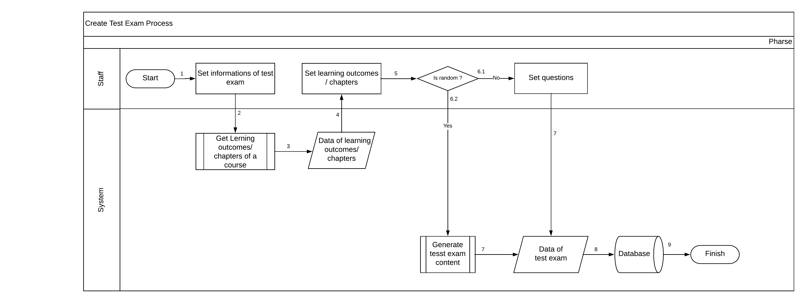
OUR SOLUTIONS
ISSUE
LEARNING OUTCOMES
SOLUTIONS
DEMO
Notes:
Bổ sung slide tổ chức dữ liệu cho phần này

Slide 71
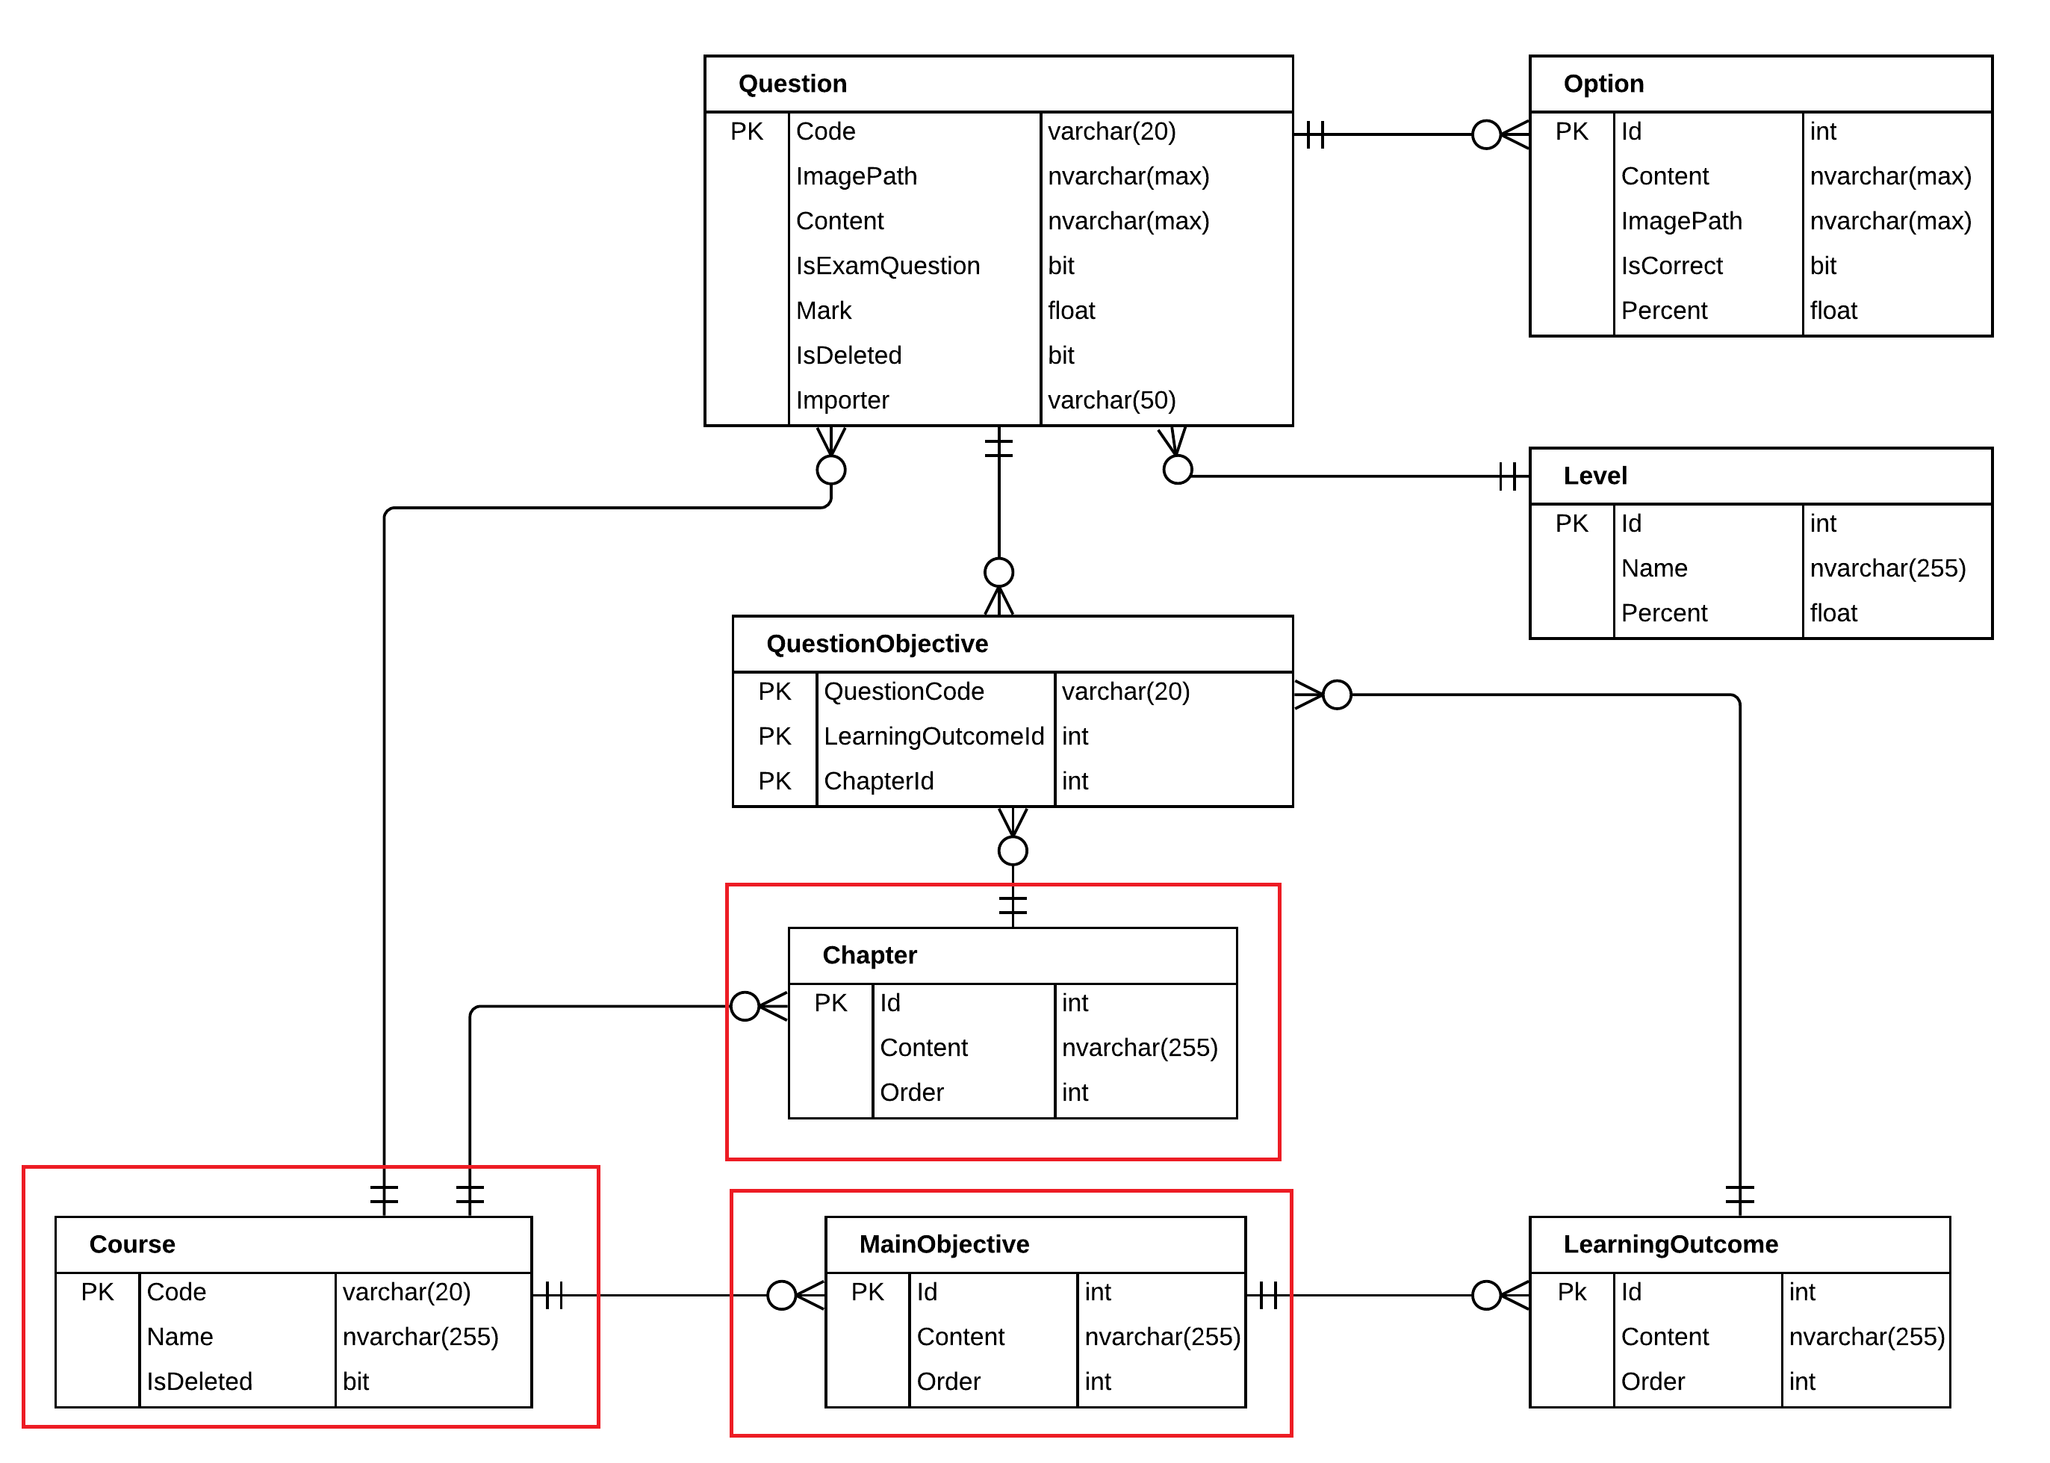
OUR SOLUTION
ISSUE
LEARNING OUTCOMES
SOLUTIONS
DEMO

Slide 72
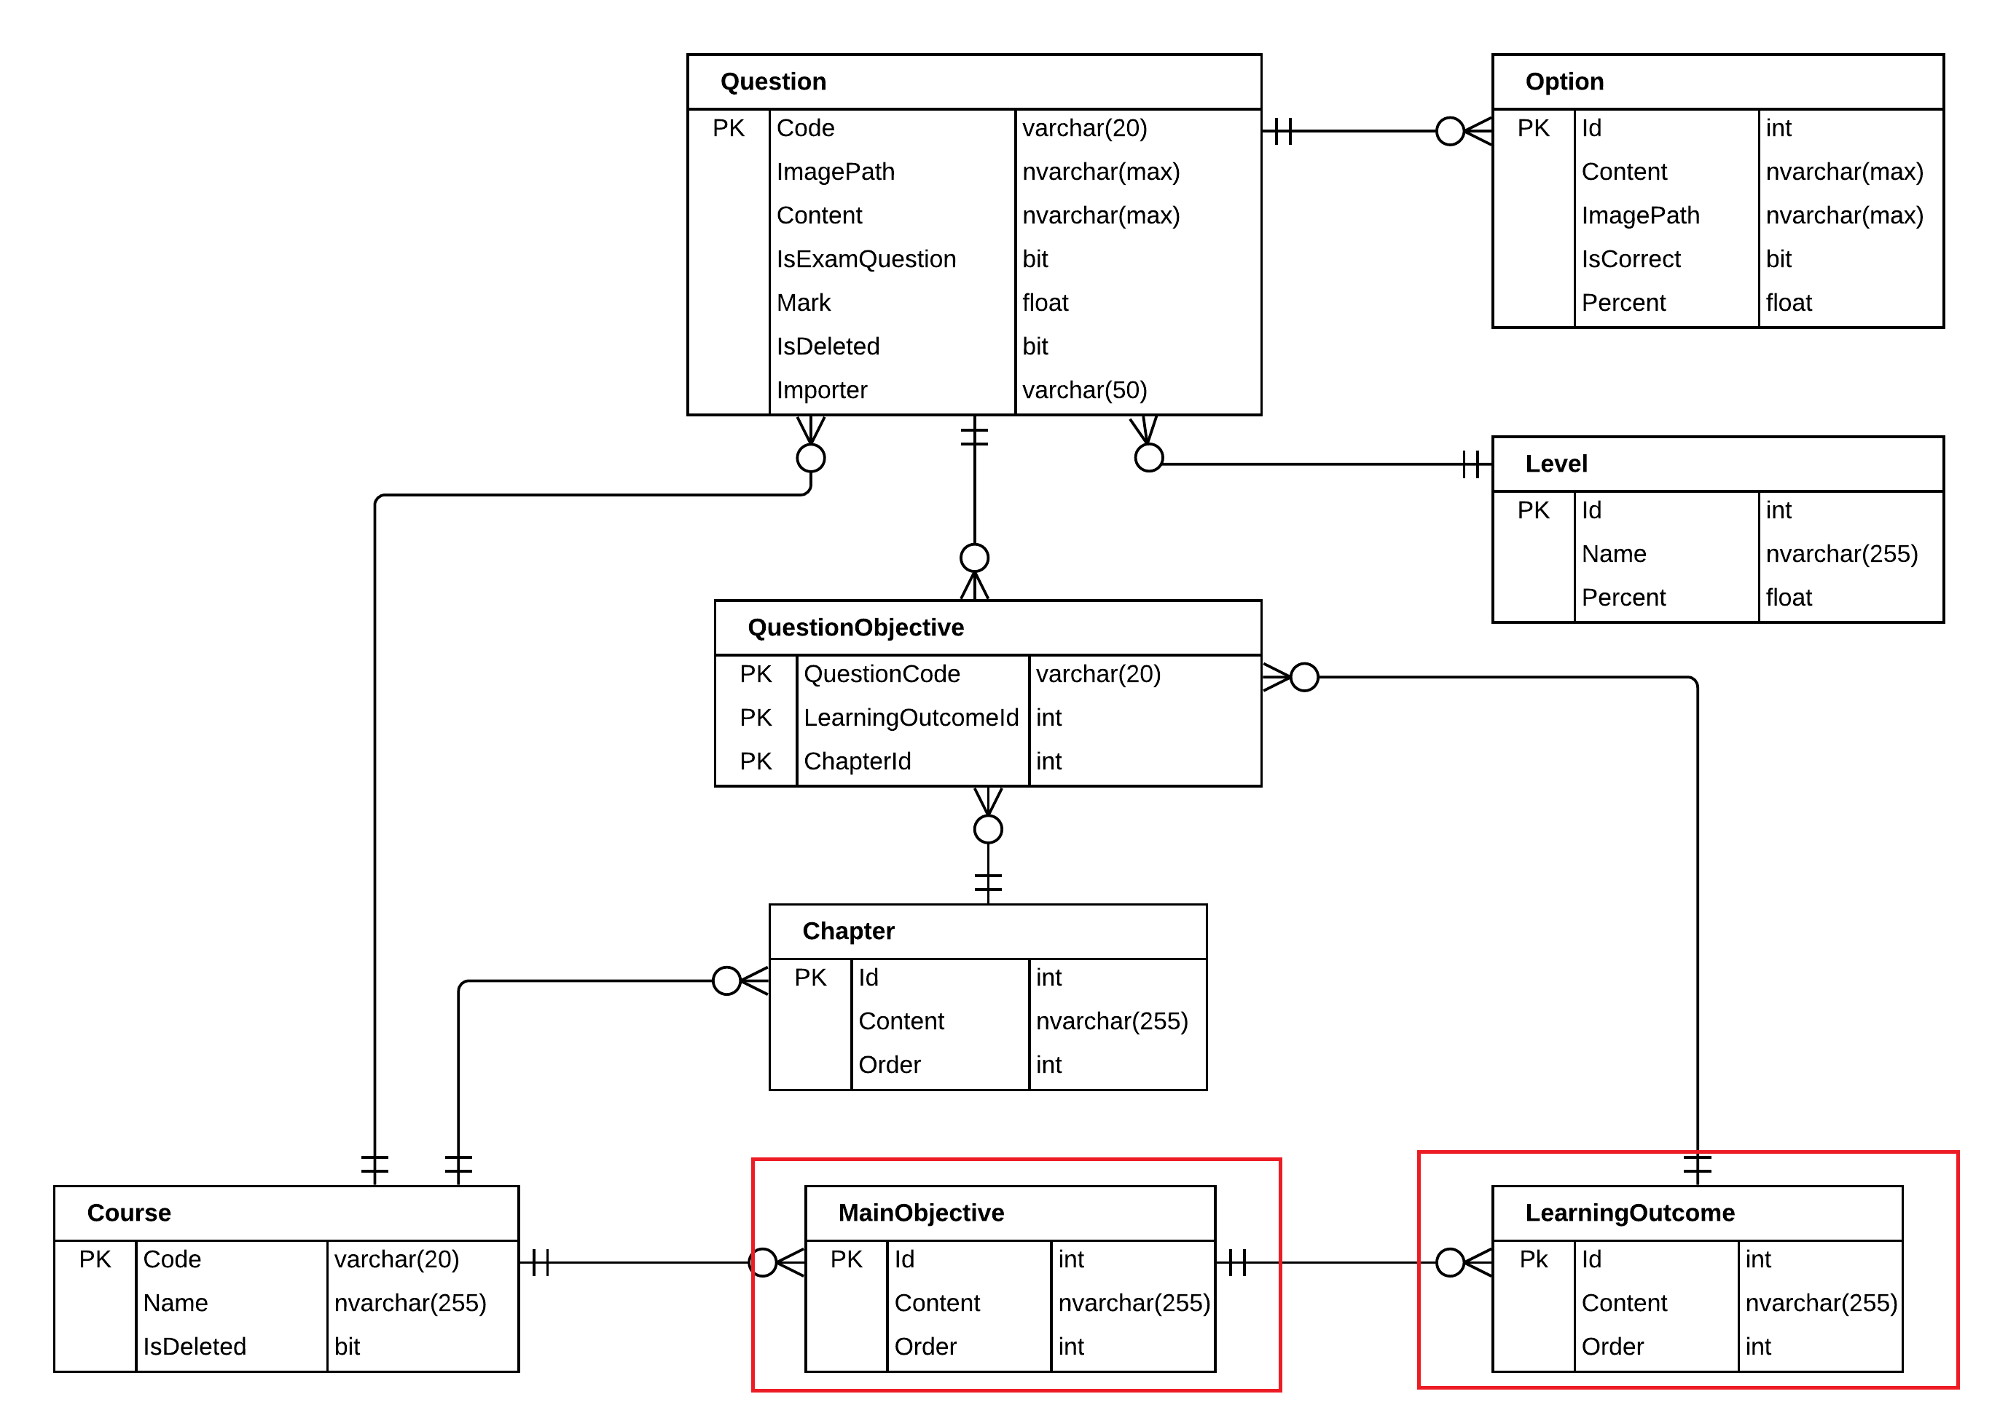
OUR SOLUTION
ISSUE
LEARNING OUTCOMES
SOLUTIONS
DEMO

Slide 73
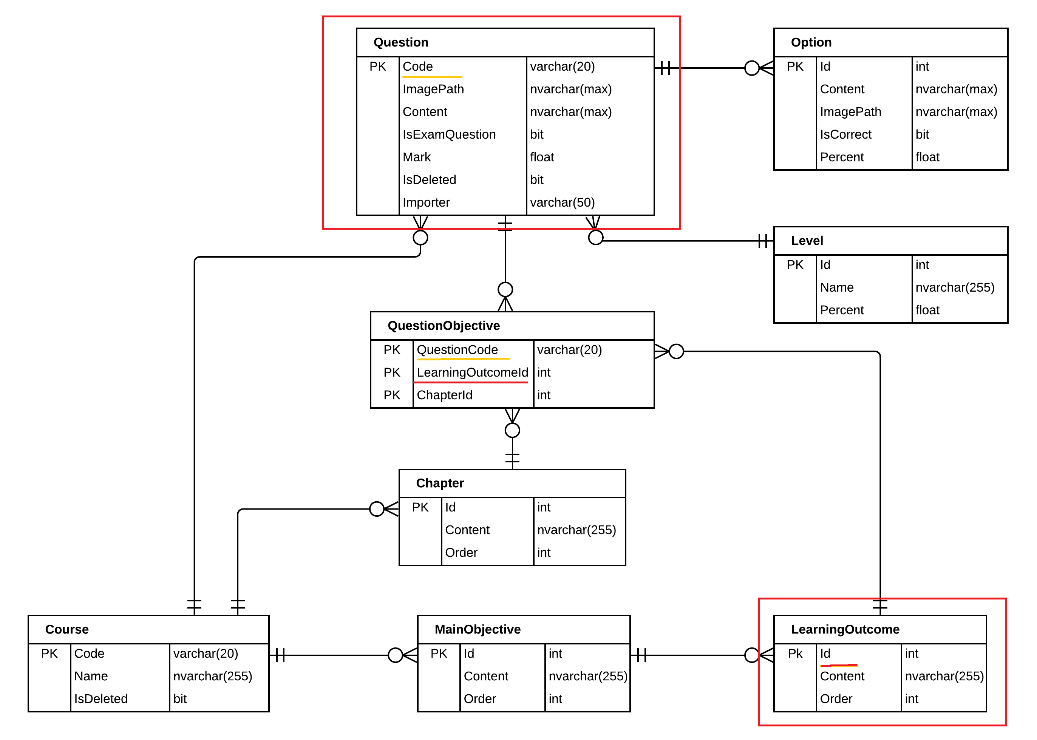
OUR SOLUTION
ISSUE
LEARNING OUTCOMES
SOLUTIONS
DEMO

Slide 74
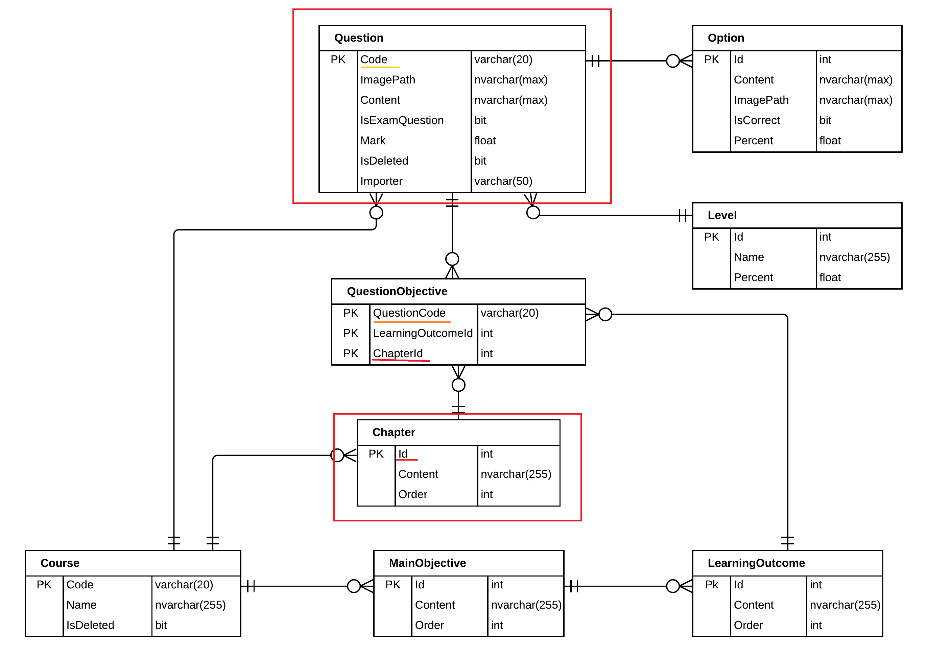
OUR SOLUTION
ISSUE
LEARNING OUTCOMES
SOLUTIONS
DEMO

Slide 75
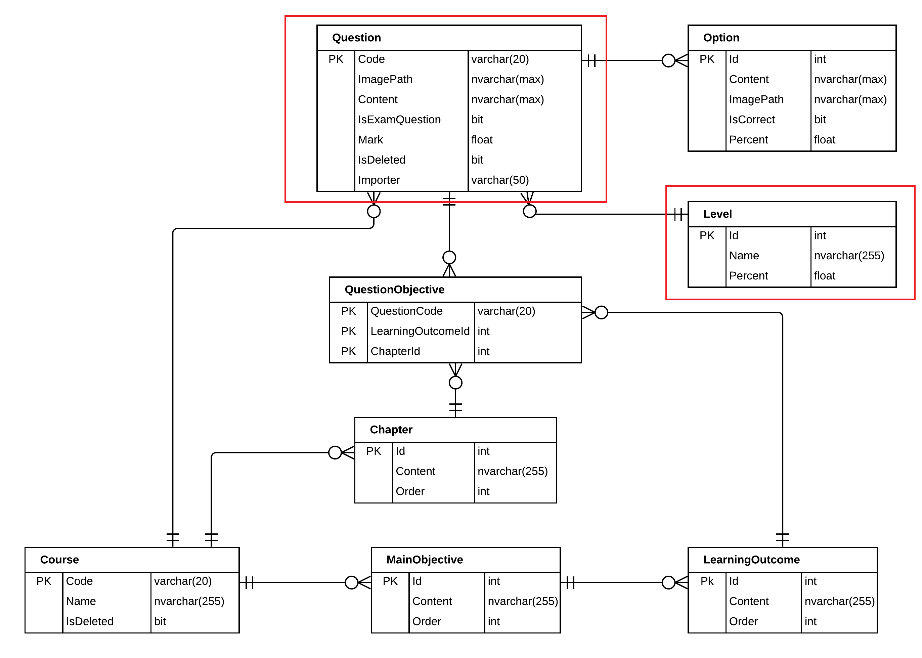
OUR SOLUTION
ISSUE
LEARNING OUTCOMES
SOLUTIONS
DEMO

Slide 76
GENERATE EXAM DEMO PROCESS
ISSUE
LEARNING OUTCOMES
SOLUTIONS
DEMO

Slide 77
APPROVING ISSUE



GENERATE TEST EXAM
CREATE EXAM
Staff
Staff
Teacher
Teacher
Student
CREATE QUESTIONS
APPROVE TEST EXAM
if teacher reject test exam

Slide 78

APPROVING ISSUE
ISSUE
SOLUTIONS BLOCKCHAIN
SYNCHRONIZE UPDATE
DEMO
- A staff wants to assign lecturer for approve the test exam.
Staff

Slide 79
APPROVING ISSUE
ISSUE
SOLUTIONS BLOCKCHAIN
SYNCHRONIZE UPDATE
DEMO
- A staff wants to assign lecturer for approve the test exam.
1. assign approver
Staff
Lecturer

Slide 80
APPROVING ISSUE
ISSUE
SOLUTIONS BLOCKCHAIN
SYNCHRONIZE UPDATE
DEMO
- A staff wants to assign lecturer for approve the test exam.
1. assign approver
2. review
Staff
Lecturer
Test exam

Slide 81
APPROVING ISSUE
ISSUE
SOLUTIONS BLOCKCHAIN
SYNCHRONIZE UPDATE
DEMO
- A staff wants to assign lecturer for approve the test exam.
1. assign approver
2. review
Staff
Lecturer
Test exam
During review process

Slide 82
APPROVING ISSUE
ISSUE
SOLUTIONS BLOCKCHAIN
SYNCHRONIZE UPDATE
DEMO
- Before approve, the lecturer found wrong questions in the test exam. So he decided to update test’s content.
Lecturer

Slide 83

APPROVING ISSUE
ISSUE
SOLUTIONS BLOCKCHAIN
SYNCHRONIZE UPDATE
DEMO
- Before approve, the lecturer found wrong questions in the test exam. So he decided to update test’s content.
1. update
Lecturer
Questions

Slide 84
APPROVING ISSUE
ISSUE
SOLUTIONS BLOCKCHAIN
SYNCHRONIZE UPDATE
DEMO
- Before approve, the lecturer found wrong questions in the test exam. So he decided to update test’s content.
1. update
2. approve
Lecturer
Questions
Test exam

Slide 85
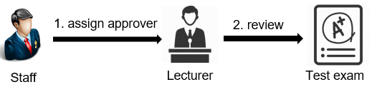
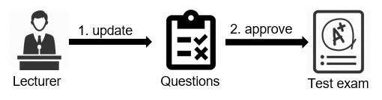
APPROVING ISSUE
ISSUE
SOLUTIONS BLOCKCHAIN
SYNCHRONIZE UPDATE
DEMO
Issue:
Manual approval process.
Waste of time and resources for document.
Update question in the test exam not synchronize to question bank.

Slide 86
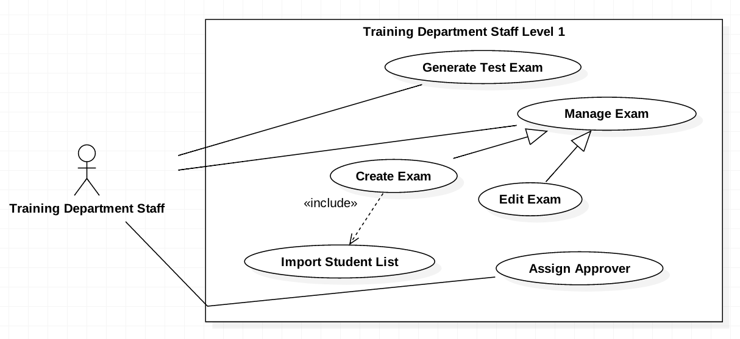
APPROVE TEST EXAM SOLUTION
ISSUE
SOLUTIONS BLOCKCHAIN
SYNCHRONIZE UPDATE
DEMO

Slide 87
APPROVE TEST EXAM SOLUTION
ISSUE
SOLUTIONS BLOCKCHAIN
SYNCHRONIZE UPDATE
DEMO

Slide 88
APPROVE TEST EXAM SOLUTION
ISSUE
SOLUTIONS BLOCKCHAIN
SYNCHRONIZE UPDATE
DEMO
01

SUPORT ONLINE APPROVAL PROCESS WITH BLOCK-CHAIN TECHNOLOGY




Slide 89
APPROVE TEST EXAM SOLUTION
ISSUE
SOLUTIONS BLOCKCHAIN
SYNCHRONIZE UPDATE
DEMO
01

SUPORT ONLINE APPROVAL PROCESS WITH BLOCK-CHAIN TECHNOLOGY

02
SYNCHRONIZE QUESTIONS IN THE TEST EXAM WITH QUESTIONS IN THE QUESTION BANK


Notes:
Quesstions the quesstion bank????

Slide 90
APPLYING BLOCKCHAIN FOR APPROVE TEST EXAM
ISSUE
SOLUTIONS BLOCKCHAIN
SYNCHRONIZE UPDATE
DEMO
Lecturer

Slide 91
APPLYING BLOCKCHAIN FOR APPROVE TEST EXAM
ISSUE
SOLUTIONS BLOCKCHAIN
SYNCHRONIZE UPDATE
DEMO
1. approve
Lecturer
Test exam

Slide 92

APPLYING BLOCKCHAIN FOR APPROVE TEST EXAM
ISSUE
SOLUTIONS BLOCKCHAIN
SYNCHRONIZE UPDATE
DEMO
1. approve
2. request a transaction
Lecturer
Test exam
The transaction represented as a “block”

Slide 93


Applying blockchain for approve test exam
ISSUE
SOLUTIONS BLOCKCHAIN
SYNCHRONIZE UPDATE
DEMO
1. approve
2. request a transaction
Lecturer
Test exam
The transaction represented as a “block”
3. broadcast
The network

Slide 94

Applying blockchain for approve test exam
ISSUE
SOLUTIONS BLOCKCHAIN
SYNCHRONIZE UPDATE
DEMO
1. approve
2. request a transaction
Lecturer
Test exam
The transaction represented as a “block”
3. broadcast
4. validate
The network
Add a new block to chain

Slide 95

Applying blockchain for approve test exam
ISSUE
SOLUTIONS BLOCKCHAIN
SYNCHRONIZE UPDATE
DEMO
1. approve
2. request a transaction
Lecturer
Test exam
The transaction represented as a “block”
3. broadcast
4. validate
5. protected
Resource
The network
Add a new block to chain

Slide 96
BLOCKCHAIN DATA STRUCTURES
ISSUE
SOLUTIONS BLOCKCHAIN
SYNCHRONIZE UPDATE
DEMO
Block 0
Block 1
Block 2
Index
Index
Index
SHA-256
Created Date
Created Date
Created Date
Previous Hash
Previous Hash
Previous Hash
Hash
Hash
Hash
Proof-of-work
Nonce
Nonce
Nonce
Data
Data
Data

Slide 97
WHAT IS PROOF–OF–WORK?
ISSUE
SOLUTIONS BLOCKCHAIN
SYNCHRONIZE UPDATE
DEMO
Prevents abuse
Consensus algorithm
Without a central intermediary, the network of participating users that develop this system need to agree on the validity of what’s being added to the ledger
Requiring a certain amount of computing work to prevent spam and tampering
Mathematical puzzle
Number used once - nonce
As the network is growing, it is facing more and more difficulties. The algorithms need more hash power to solve.
The value that's associated with a message in a cryptographic scheme, and must be unique within some specified scope

Slide 98
SYNCHRONIZE UPDATE QUESTION PROCESS
ISSUE
SOLUTIONS BLOCKCHAIN
SYNCHRONIZE UPDATE
DEMO
Teacher

Slide 99
SYNCHRONIZE UPDATE QUESTION PROCESS
ISSUE
SOLUTIONS BLOCKCHAIN
SYNCHRONIZE UPDATE
DEMO
1. Update
Teacher
Questions

Slide 100

SYNCHRONIZE UPDATE QUESTION PROCESS
ISSUE
SOLUTIONS BLOCKCHAIN
SYNCHRONIZE UPDATE
DEMO
2. synchronize
1. Update
Teacher
Questions
Question bank

Slide 101
SYNCHRONIZE UPDATE QUESTION PROCESS
ISSUE
SOLUTIONS BLOCKCHAIN
SYNCHRONIZE UPDATE
DEMO
2. synchronize
1. Update
Teacher
Questions
Question bank
3. synchronize
Test bank

Slide 102
TEST EXAM APPROVING DEMO
ISSUE
SOLUTIONS BLOCKCHAIN
SYNCHRONIZE UPDATE
DEMO

Slide 103
CREATE EXAM CURRENT SITUATIONS



GENERATE TEST EXAM
CREATE EXAM
Staff
Staff
Teacher
Teacher
Student
CREATE QUESTIONS
APPROVE TEST EXAM
if teacher reject test exam

Slide 104
CREATE EXAM CURRENT SITUATIONS
CURRENT SITUATIONS
OUR IDEA
DEMO
Staff wants to create an Exam.
Staff

Slide 105

CREATE EXAM CURRENT SITUATIONS
CURRENT SITUATIONS
OUR IDEA
DEMO
Staff wants to create an Exam.
1. Generate
Exam
Staff

Slide 106
CREATE EXAM CURRENT SITUATIONS
CURRENT SITUATIONS
OUR IDEA
DEMO
Staff wants to create an Exam.
1. Generate
Exam
Staff
2. Ask teacher
review
Teacher

Slide 107
CREATE EXAM CURRENT SITUATIONS
CURRENT SITUATIONS
OUR IDEA
DEMO
Staff wants to create an Exam.
1. Generate
Exam
Staff
2. Ask teacher
review
3. Review
Teacher

Slide 108

CREATE EXAM CURRENT SITUATIONS
CURRENT SITUATIONS
OUR IDEA
DEMO
Staff wants to create an Exam.
1. Generate
Exam
Staff
2. Ask teacher
review
3. Review
4. Assign to
contract
Teacher
Contract

Slide 109
CREATE EXAM CURRENT SITUATIONS
CURRENT SITUATIONS
CURRENT PROCESS
DEMO
Staff wants to create an Exam.
1. Generate
5. Take exam
Exam
Student
Staff
2. Ask teacher
review
3. Review
4. Assign to
contract
Teacher
Contract

Slide 110
OUR IDEA
CURRENT SITUATIONS
OUR IDEA
DEMO
Staff

Slide 111
OUR IDEA
CURRENT SITUATIONS
OUR IDEA
DEMO
1. Generate
Staff
Test exam

Slide 112
OUR IDEA
CURRENT SITUATIONS
OUR IDEA
DEMO
1. Generate
Staff
Test exam
2. Assign
teacher
Teacher

Slide 113
OUR IDEA
CURRENT SITUATIONS
OUR IDEA
DEMO
1. Generate
Staff
Test exam
2. Assign
teacher
3. Approve
Teacher

Slide 114
OUR IDEA
CURRENT SITUATIONS
OUR IDEA
DEMO
1. Generate
4. Public
Staff
Manager
Test exam
2. Assign
teacher
3. Approve
Teacher

Slide 115

OUR IDEA
CURRENT SITUATIONS
OUR IDEA
DEMO
1. Generate
4. Public
Staff
Manager
Test exam
5. Create
2. Assign
teacher
5. Apply
3. Approve
Teacher
Exam

Slide 116
OUR IDEA
CURRENT SITUATIONS
OUR IDEA
DEMO
1. Generate
4. Public
Staff
Manager
Test exam
5. Create
2. Assign
teacher
5. Apply
3. Approve
6. Take
Teacher
Exam
Student

Slide 117
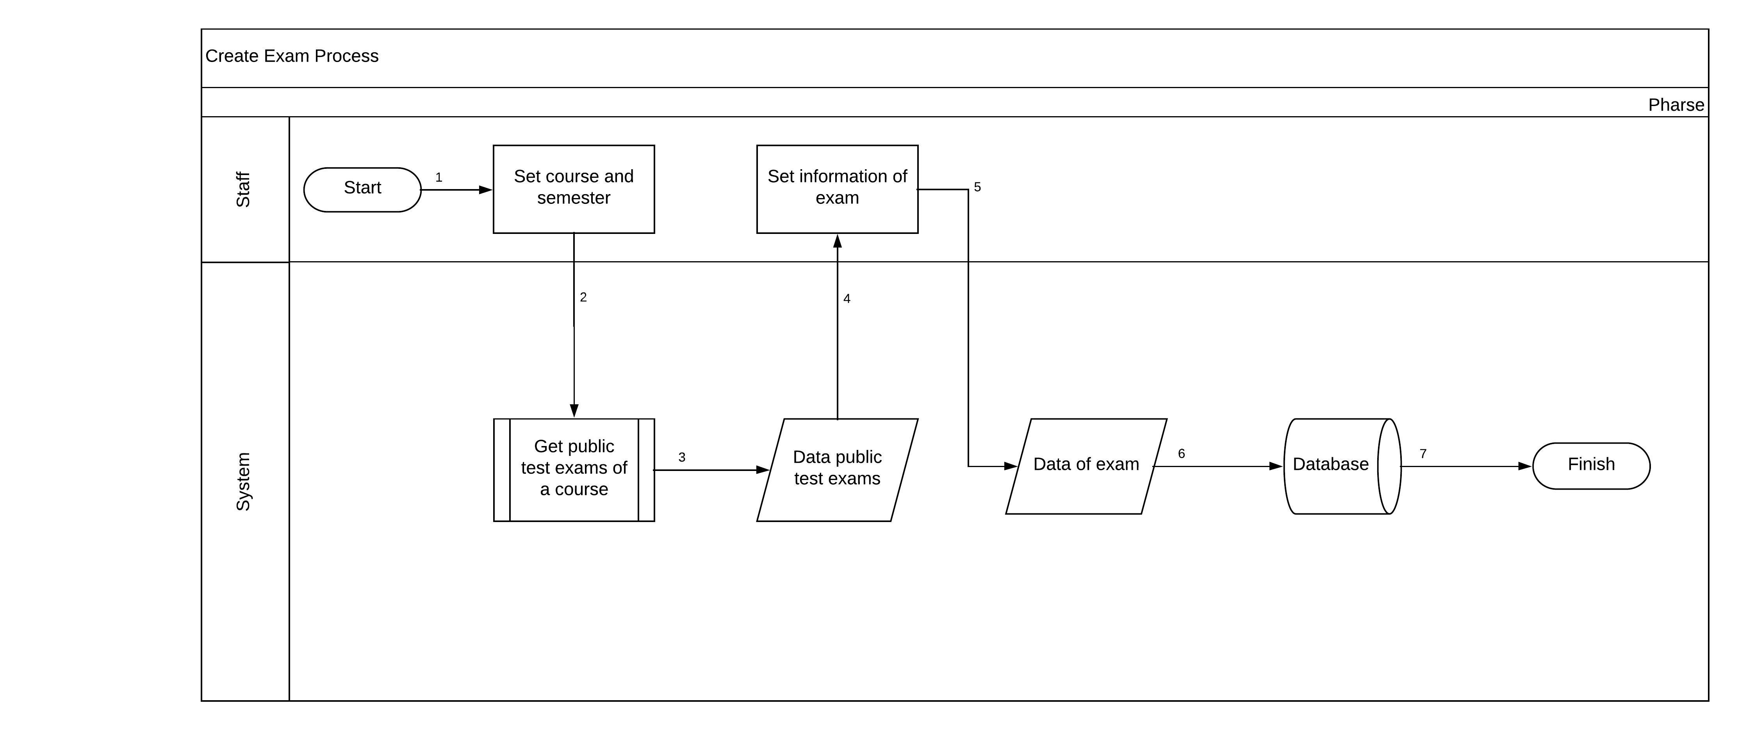
OUR IDEA
CURRENT SITUATIONS
OUR IDEA
DEMO

Slide 118
DEMO CREATE EXAM PROCESS
CURRENT SITUATIONS
OUR IDEA
DEMO

Slide 119
TAKE TEST EXAM ISSUE



GENERATE TEST EXAM
CREATE EXAM
Staff
Staff
Teacher
Teacher
Student
CREATE QUESTIONS
APPROVE TEST EXAM
TAKE A TEST EXAM
if teacher reject test exam

Slide 120
EXAM TOOL ISSUE
ISSUE
SOLUTIONS
HANDLING
ADVANTAGES
DEMO
RUN (2)
Exam Tool
Student
RUN (1)
Unaccepted Tool

Slide 121
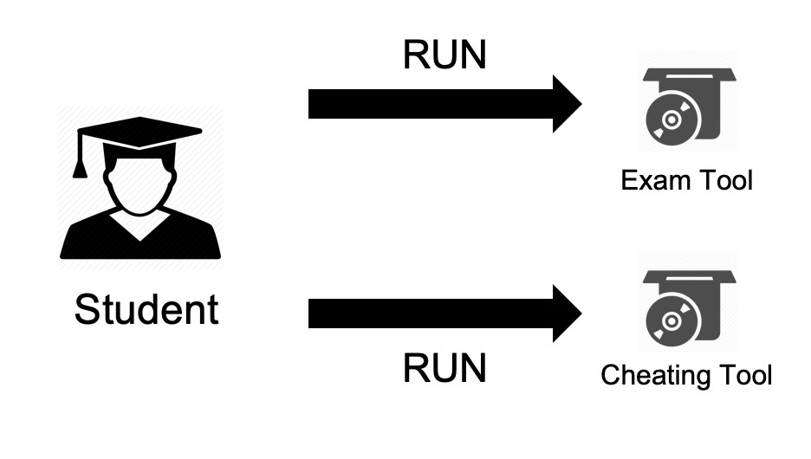
EXAM TOOL ISSUE
ISSUE
SOLUTIONS
HANDLING
ADVANTAGES
DEMO
Issue:
Managing unaccepted tool is inflexible.
Exam Tool management feature is limit.
Notes:
ok

Slide 122
OUR SOLUTION
ISSUE
SOLUTIONS
HANDLING
ADVANTAGES
DEMO
Computer’s Process Management
Black listed processes
Accepted processes
Exam Tool
Notes:
Đợi tao copy

Slide 123
OUR SOLUTION
ISSUE
SOLUTIONS
HANDLING
ADVANTAGES
DEMO
Computer’s Process Management
Get Student Screen
Black listed processes
Accepted processes
- Get the screen of a specify student
Exam Tool
Notes:
Đợi tao copy

Slide 124
OUR SOLUTION
ISSUE
SOLUTIONS
HANDLING
ADVANTAGES
DEMO
Computer’s Process Management
Get Student Screen
Black listed processes
Accepted processes
- Get the screen of a specify student
Scan Student by Process
Exam Tool
- Get students who are using specify process
Notes:
Đợi tao copy

Slide 125
OUR SOLUTION
ISSUE
SOLUTIONS
HANDLING
ADVANTAGES
DEMO
Computer’s Process Management
Get Student Screen
Black listed processes
Accepted processes
- Get the screen of a specify student
Scan Student by Process
Exam Tool
- Get students who are using specify process
Prevent Multi-Login
Avoid cheating from the outside of the exam room
Notes:
Đợi tao copy

Slide 126
OUR SOLUTION
ISSUE
SOLUTIONS
HANDLING
ADVANTAGES
DEMO
Computer’s Process Management
Get Student Screen
Black listed processes
Accepted processes
- Get the screen of a specify student
Scan Student by Process
Exam Tool
- Get students who are using specify process
Locally save the test exam
Prevent Multi-Login
Periodically save the student test exam in local
With hashing
Avoid cheating from the outside of the exam room
Notes:
Đợi tao copy

Slide 127
OUR SOLUTION
ISSUE
SOLUTIONS
HANDLING
ADVANTAGES
DEMO
Computer’s Process Management
Get Student Screen
Black listed processes
Accepted processes
- Get the screen of a specify student
Kill Process in real time
Scan Student by Process
Real time scan and kill Student Process
Exam Tool
- Get students who are using specify process
Locally save the test exam
Prevent Multi-Login
Periodically save the student test exam in local
With hashing
Avoid cheating from the outside of the exam room

Slide 128
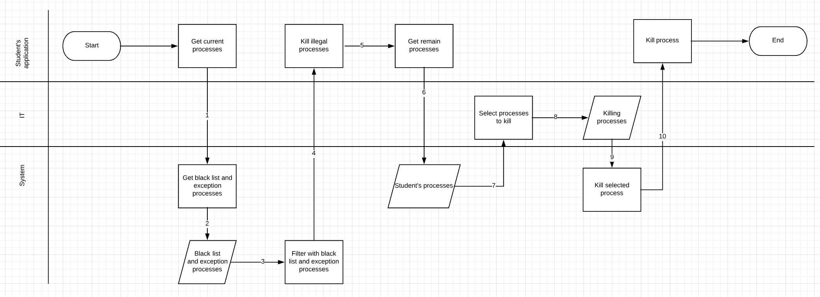
PROCESS KILLING FLOW HANDLING
ISSUE
SOLUTIONS
HANDLING
ADVANTAGES
DEMO
Notes:
Đợi tao 2p

Slide 129
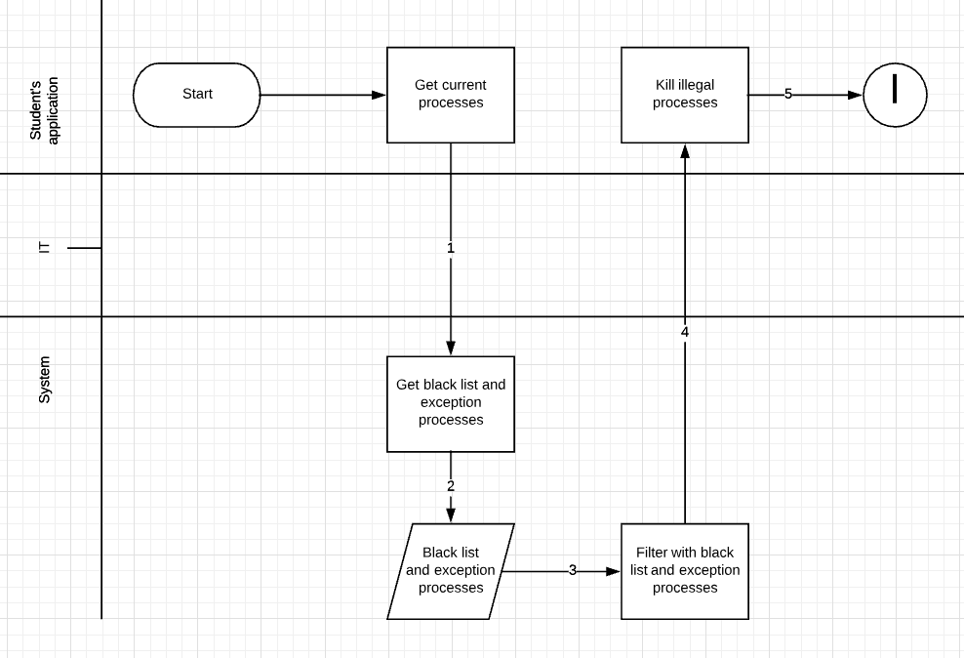
PROCESS KILLING FLOW HANDLING
ISSUE
SOLUTIONS
HANDLING
ADVANTAGES
DEMO
Notes:
Đợi tao 2p

Slide 130
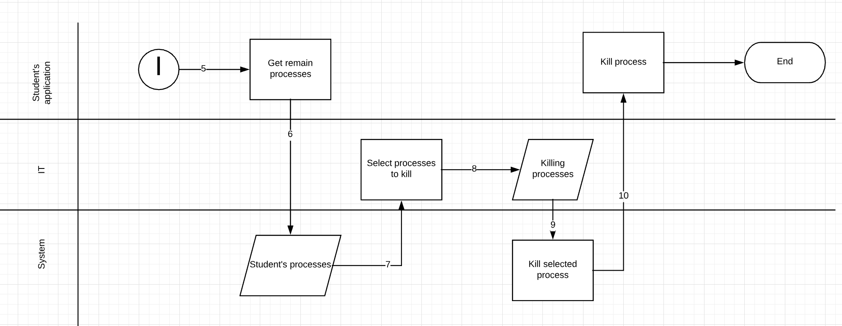
PROCESS KILLING FLOW HANDLING
ISSUE
SOLUTIONS
HANDLING
ADVANTAGES
DEMO
Notes:
Đợi tao 2p

Slide 131
ADVANTAGES
ISSUE
SOLUTIONS
HANDLING
ADVANTAGES
DEMO
Reduce Cheating
Save Network Bandwidth
Guaranteed student test exam

Manage unaccepted tool flexibly
Notes:
ok???

Slide 132
Exam Tool Demo
ISSUE
SOLUTIONS
HANDLING
ADVANTAGES
DEMO
Student
RUN (1)
Cheating Tool

Slide 133
Exam Tool Demo
ISSUE
SOLUTIONS
HANDLING
ADVANTAGES
DEMO
RUN (2)
Exam Tool
Student
RUN (1)
Cheating Tool

Slide 134
Exam Tool Demo
ISSUE
SOLUTIONS
HANDLING
ADVANTAGES
DEMO
RUN (2)
Exam Tool
process name (3)
Student
RUN (1)
Cheating Tool

Slide 135
Exam Tool Demo
ISSUE
SOLUTIONS
HANDLING
ADVANTAGES
DEMO
RUN (2)
Send to (4)
Exam Tool
Management page
process name (3)
Student
RUN (1)
Cheating Tool

Slide 136
Exam Tool Demo
ISSUE
SOLUTIONS
HANDLING
ADVANTAGES
DEMO
Scan student by process (5)
RUN (2)
Send to (4)
Exam Tool
Management page
process name (3)
Student
RUN (1)
Cheating Tool

Slide 137
Exam Tool Demo
ISSUE
SOLUTIONS
HANDLING
ADVANTAGES
DEMO
Scan student by process (5)
RUN (2)
Send to (4)
Exam Tool
Management page
process name (3)
get student screen (6)
Student
RUN (1)
Cheating Tool

Slide 138
OUTCOME & LIMITATION
3

Slide 139
OUTCOME
01
IMPROVE HIGH TEST EXAM QUALITY

Slide 140
OUTCOME
01
IMPROVE HIGH TEST EXAM QUALITY
02
EXAM TOOL MANAGEMENT FLEXIBLY

Slide 141
OUTCOME
01
IMPROVE HIGH TEST EXAM QUALITY
02
EXAM TOOL MANAGEMENT FLEXIBLY
03
PREVENT DUPLICATE QUESTION IN QUESTION BANK

Slide 142
OUTCOME
01
IMPROVE HIGH TEST EXAM QUALITY
02
EXAM TOOL MANAGEMENT FLEXIBLY
03
PREVENT DUPLICATE QUESTION IN QUESTION BANK

04
APPROVE PROCESS MORE SAFETY

Slide 143
LIMITATIONS
EXAM TOOL JUST RUNNING ON WINDOW
NOT SUPPORTING ALL KINDS OF QUESTIONS

Slide 144
FUTURE PLAN
4

Slide 145
FUTURE PLAN
SUPPORT ALL QUESTION TYPE
Save Network Bandwidth
RANDOM TEST EXAM BY MULTI CONDITIONS

SUPPORT MAC OS FOR EXAMTOOL

Slide 146

Q & A

